Slide 1
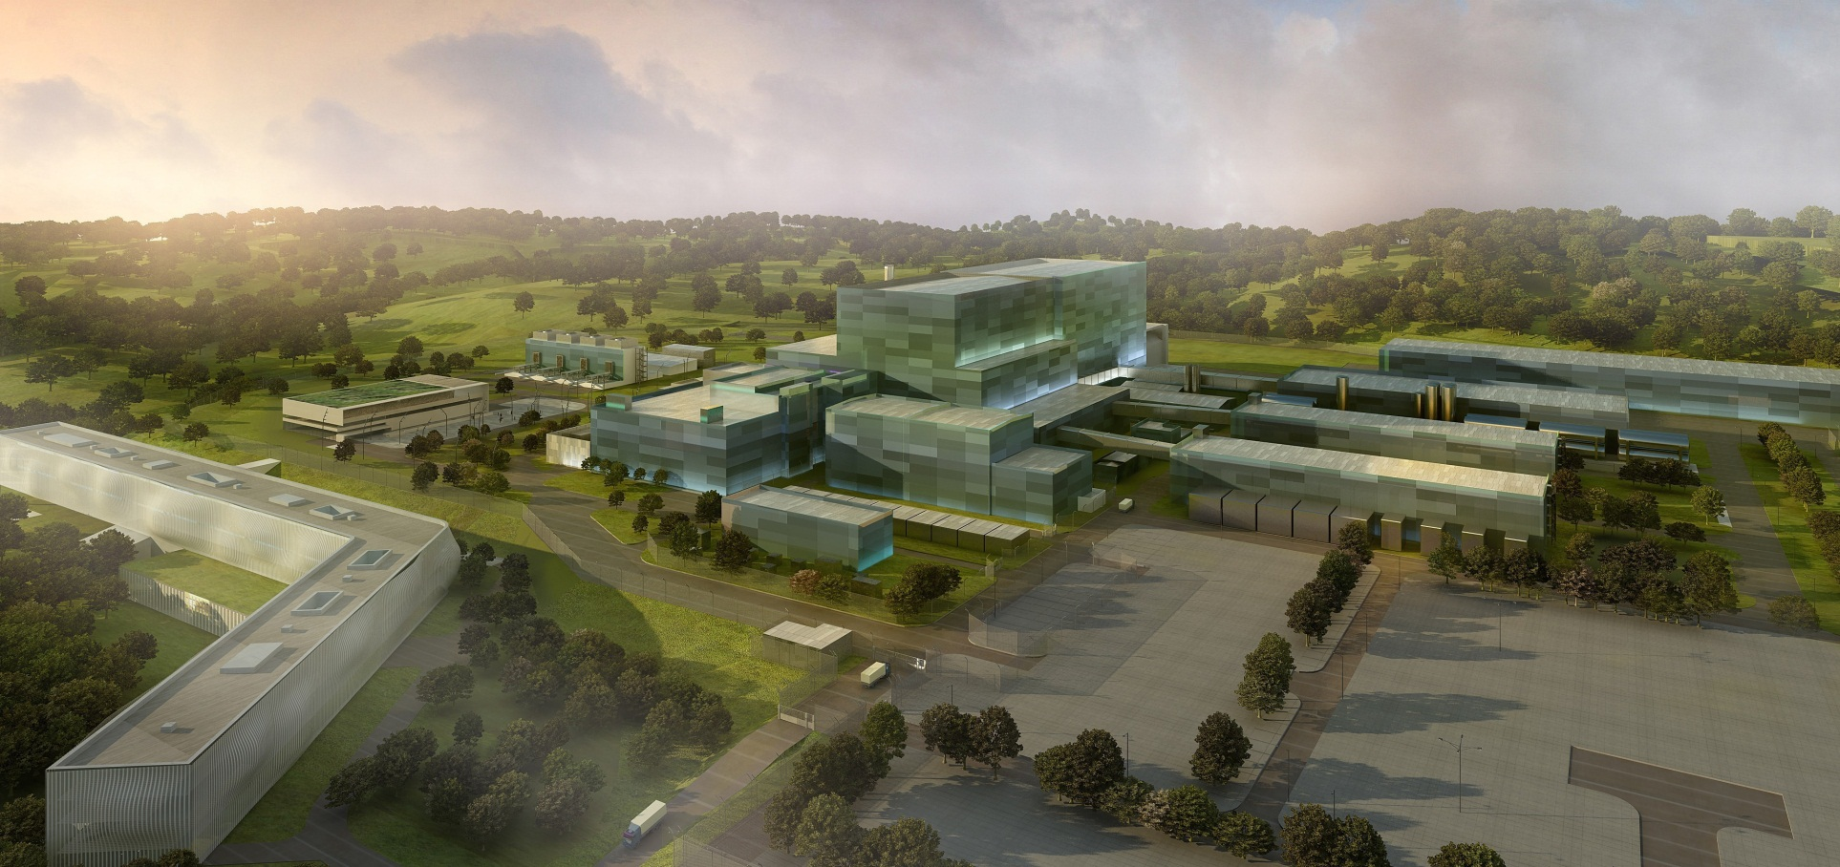
Status of Fast Controller EPICS Supports for ITER Project
Vishnu Patel
ITER Organization
Control System Division
Disclaimer: The views and opinions expressed herein do not necessarily reflect those of the ITER Organization

Slide 2
Content
Introduction
Hardware Architecture
Software Architecture
PXI-6259
Timing Board
PXIe-6368
PXI-6528
cRIO / FlexRIO bundles.
Conclusion

Slide 3
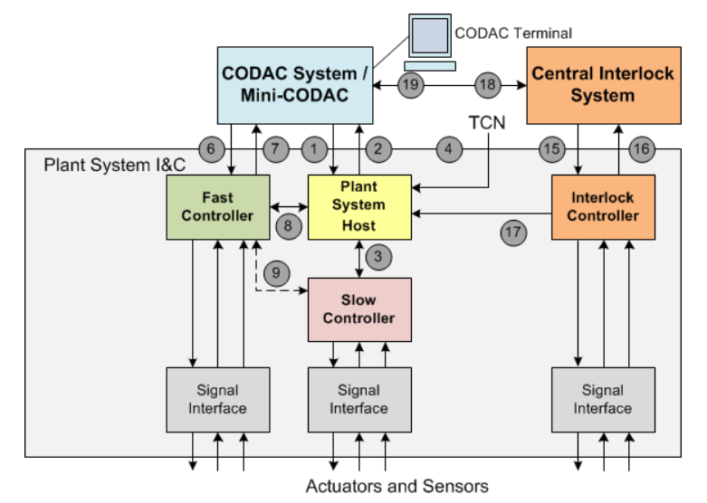
Introduction of I&C Architecture

Slide 4
Hardware Architecture

Slide 5
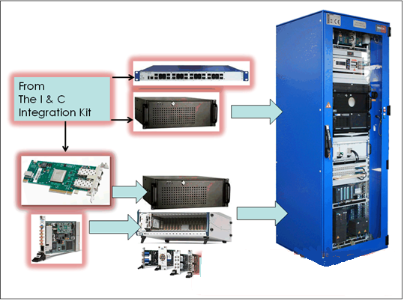
Hardware Architecture

Slide 6
Standard Hardware Support
Supported I/O boards:
N.I. PXI-6682/PXI-6683H : Synchronization and timing (IEEE1588-2008 / TCN)
N.I. PXI-6259: multi-function data acquisition
16bits analog input channels (16 Diff. /32 Single Ended) (1.25MS/s)
16bits analog output channels (4) (2.86 MS/s)
digital input/output channels (48)
N.I. PXIe-6368: High Performance multi-function data acquisition
16bits analog input channels (16 Diff.) (Simultaneous, 2MS/s)
16bits analog output channels (4) (3.3 MS/s)
digital input/output channels (48)
N.I. PXI-6528 : Digital I/O
24 optically isolated input channels
24 solid-state relay output channels
±60VDC channel to channel Isolation

Slide 7
Standard Hardware Support
Supported cRIO I/O modules:
N.I. 9425/9426 : Sinking / Sourcing Digital Input -7µS, 32 Channels 12/24V
N.I. 9476 /9477: Sourcing - 500 µS / 6-36V /250mA
: Sinking - 8 µS /5-60V /625 mA
32 Channels Digital Output
N.I. 9205 : 32 x AI (16-bit, ±200mV to ±10V, 250kS/s)
N.I. 9264 : 16 x AO (16-bit, ±10V, isolation 60VDC, 25 kS/s/ch simultaneous )
Supported FlexRIO I/O board bundles:
N.I. PXIe 7966R/5761R : FPGA / ADC Bundle (14-bits, 2.07Vpk-pk, 250MS/s, 4 ch + DIO)
N.I. PXIe 7961R/6581 : FPGA / DIO Bundle (100MHz, 54 DIO)
N.I. PXIe 7966R/1483 : FPGA / Image Acquisition Bundle
Camera Link (10-tap, 80-bit images)
20 to 85 MHz pixel clock, 4 TTL DO, 2 Optical DI, 1 Quadrature encoder input
The Supported boards are listed in the ITER Catalog of I&C products - Fast Controllers (345X28).

Slide 8
Software Architecture

Slide 9
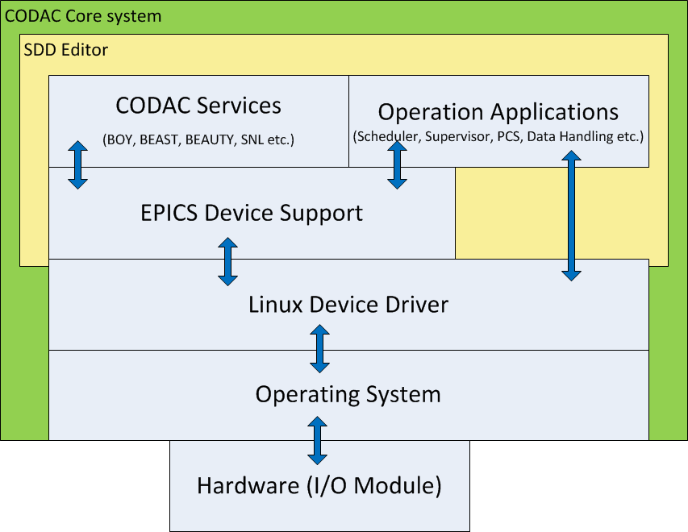
Software Applications
CODAC Core System
Operation Applications
The main challenge for CODAC is INTEGRATION

Slide 10
CODAC Core System (CCS)
CODAC
CODAC Terminal
Operator Interface (OPI)
Alarm views
Data plots
Control System Studio HMIs
Alarm server
Archive Server
CODAC Server
Alarm handling
Archiving
PON / CA
PSH:
I&C monitoring
PLCs Gateway
I&C coordination
PSH
PLC IOC
PSH IOC
Fast Controller
RT task
PCF
IOC
Fast Controller:
I/O interface
HPN interfaces: TCN, SDN, DAN
RT control
PLC
I/O
TCN
SDN
DAN

Slide 11
Fast Controller software
OS: Red Hat Enterprise Linux for the x86-64 architecture (RHEL x86_64)
CCS 5.x -> RHEL 6.5
CCS 6.x -> RHEL 7.0
For fast feedback control: real-time enabled RHEL MRG-R
Optimized kernel for real-time applications
More deterministic latencies / reduced jitter
Framework: EPICS and ASYN
ITER adopted open source control system EPICS
CCS 5.4 -> EPICS 3.15 , asynDriver 4.30
CCS 6.0 -> EPICS 3.16 , asynDriver 4.31

Slide 12
EPICS Device Support
Basic EPICS Device Support
PXI-6259: multi-function data acquisition.
asynDriver based Device Support
PXI-6682 & PXI-6683h : Synchronization and timing.
PXIe-6368: High Performance multi-function data acquisition.
PXI-6528 : Digital I/O.
cRIO and flexRIO bundles.
Future device Support
PXIe-6363: multi-function data acquisition boards.

Slide 13
PXI 6259 DAQ Board

Slide 14
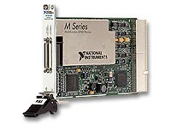
PXI 6259 Main functions
All DAQ modes support
Software timed acquisition
Hardware timed acquisition
Finite sample mode
Continuous mode
AI/AO triggering support
Start, Stop trigger
Pause trigger (Activate/Deactivate DAQ/Data generation)

Slide 15
PXI 6259 Board functions
General
Device Information
Device and Channel status
Software version
Clock Settings
Sampling rate
Clock Source
Clock divider
Triggering
Set trigger (Software or Hardware)
Pre & Post trigger
DIO configuration
Analog Output configuration.
General purpose counter
Signal routing

Slide 16
Timing Boards (PXI-6682 & PXI-6683H)

Slide 17
Timing Boards Functions
Receive ITER time as PTP (IEEE 1588-2008)
Synchronization of system time with Board time
Generate Future time events, Pulse and Clocks
Front panel connector
PXI backplane lines
Signal routing
Clock routing
Accurate Time-stamping of event
Board triggers
External events (Front panel connector & Backplane lines)
Pulse sequence Programming on the selected terminal.

Slide 18
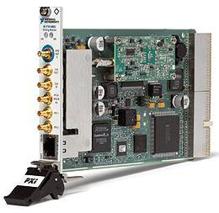
Timing Boards (PXI-6682 & PXI-6683H)
Synchronization(50ns rms)
Clock generation
Synchronized event generation.
Signal time stamping.
Common software for both boards
PFI0-PFI2 (FTEs and generated clocks)
Clock input (not in PXI-6683H)
Clock output
Clock board (10MHz)
Backplane clock (10MHz)
PXI trigger bus (8 lines)

Slide 19
PXIe-6368 DAQ Board

Slide 20
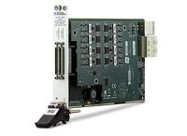
PXIe-6368 DAQ Board Function
Read Device information (Status, Software Version…)
Set configuration parameter for Analog Input
Dynamic AIO/DIO configuration with EPICS PVs.
Acquisition mode.
Continuous
Finite sample
Retriggerable finite sample
Reference triggered
waveform and ai record support for Analog input.
Board level and Channel level EPICS Template.

Slide 21
PXI-6528 DIO Board

Slide 22
PXI-6528 DIO Board Functions
Read Device information
Bit and Byte write/read on hardware port (3 input and 3 output ports)
Signal routine.
Watchdog configuration
Level change on watchdog
Level change detection
Input port filter
Output port Power up state
client / asynUser
Byte
Bit
interface
driver
bus controller (port)

Slide 23
Compact RIO & Flex RIO

Slide 24
Design Methodology
Windows Host

Slide 25
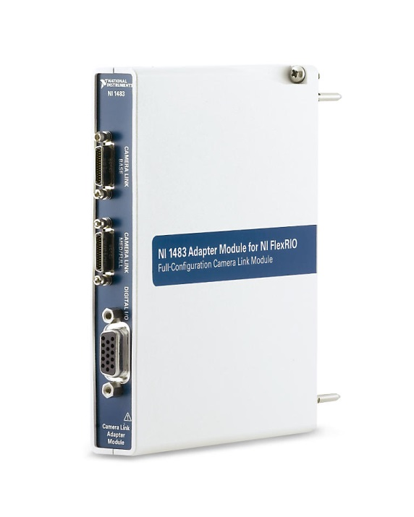
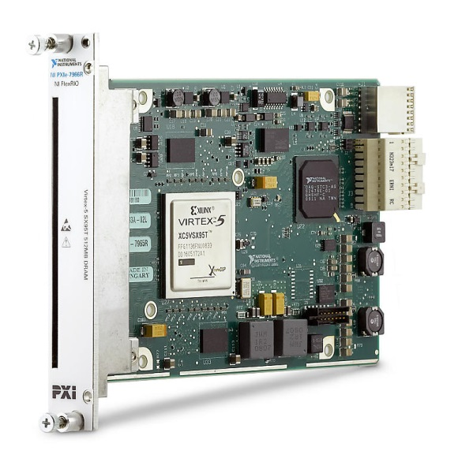
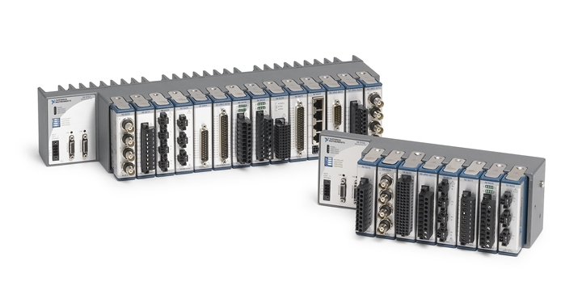
cRIO & FlexRIO board functions
Read Device information (Status, Software Version…)
Dynamic IO configuration with EPICS PVs.
waveform and ai record support for Analog input.
DMA Acquisition and Data transfer between board and controller.
Image acquisition using cameralink – serial line for camera configuration.
Signal Generation (DDS)
Board level and Channel level EPICS Templates for each bundles.

Slide 26
Conclusion
ITER Fast Controller EPICS device supports are stable.
It is well integrated with ITER CODAC Core System.
Developed templates are useful for fast application development.
We will continue to extend and improve the support.
Thank you

